Slide 1
Trust Fund Recovery Penalty
What is it and how does it work?

Slide 2
What is it?
The Trust Fund Recovery Penalty (TFRP) is a penalty assessed against responsible parties.
The Trust Fund amount is the total of taxes that were held in trust by a company on behalf of the federal government.
Most often this is money withheld from an employee's paycheck for their SSA, Medicare, and W-4 withholding.
It does not include the employer’s portion of SSA & Medicare.

Slide 3
Employer’s share of SSA & Medicare
Trust Fund Taxes
Employer Pays employee
Less: Employee’s W-4 Withholding, SSA & Medicare
Government
Employee’s take home pay

Slide 4
 |  |  |  |  | 1 Qtr. and
 |  |  |  |  | x 10 employees
Employee's Pay |  |  | $5,000.00 |  | $ 150,000.00
Less: | W-4 WH | 10% | $ 500.00 | Trust Fund | $ 15,000.00
Less: | SSA | 6.20% | $ 310.00 | Trust Fund | $ 9,300.00
Less: | Medicare | 1.45% | $ 72.50 | Trust Fund | $ 2,175.00
 |  |  | $ 882.50 | Trust Fund | $ 26,475.00
Employee take home: |  |  | $4,117.50 |  | $ 123,525.00
Employers Share:
 | SSA | 6.20% | $ 310.00 | Not Trust Fund | $ 9,300.00
 | Medicare | 1.45% | $ 72.50 | Not Trust Fund | $ 2,175.00
 |  |  | $ 382.50 |  | $ 11,475.00
 |  |  | Total Tax Bill |  | $ 37,950.00
 |  |  | Trust fund portion |  | $ 26,475.00

Slide 5
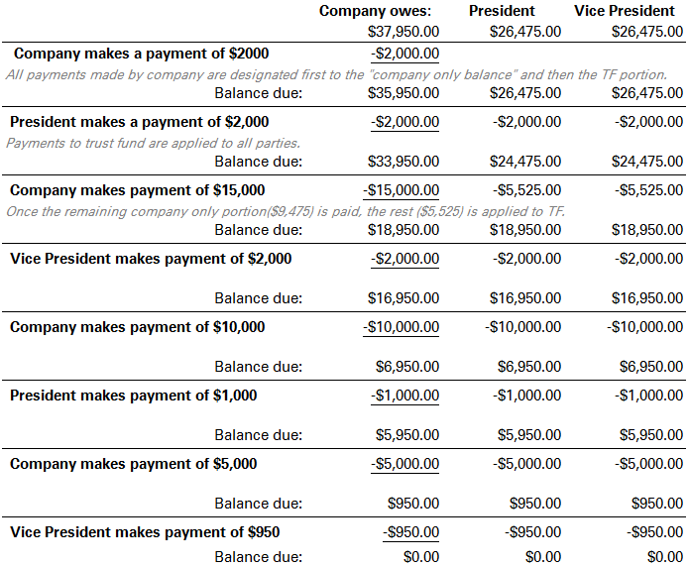
IRS conducts a Trust Fund Investigation. The President & Vice President are determined to be responsible.
The IRS doesn’t care who makes the payment.
Each party is set up on a payment plan that considers their individual ability to pay. If financial analysis of one party shows an ability to pay $500 per month, that’s what the IRS will set them up on.
If another party’s analysis shows they can’t pay anything, they will be put in “not collectable status”.
And of course, the company will pay as analysis shows they can.
Each party stands on their own.

Slide 6
RECAP
Trust Fund money is the money that the employer was supposed to hold & pay over to the government
When this is not done, the employer has in effect kept their employee’s money for their own use.
Anyone who had the responsibility to collect and pay those taxes and who willfully did not do so, can
be held liable for the Trust Fund taxes
The trust fund assessment is Instead, penalty in the amount of the tax. Each person deemed to be
responsible is then assessed that penalty.
There is no concession given for “share of responsibility”, “who has paid $X.xx, etc. Each person & the
company owe the amount assessed completely
The IRS does not collect the full penalty/tax from multiple people and the company. Instead, they
collect the amount in full, from any/all of the responsible people. Each time a payment is made
on the trust fund, no matter what party it came from, all responsible parties and the company
balance drops the same amount.

